Slide 1
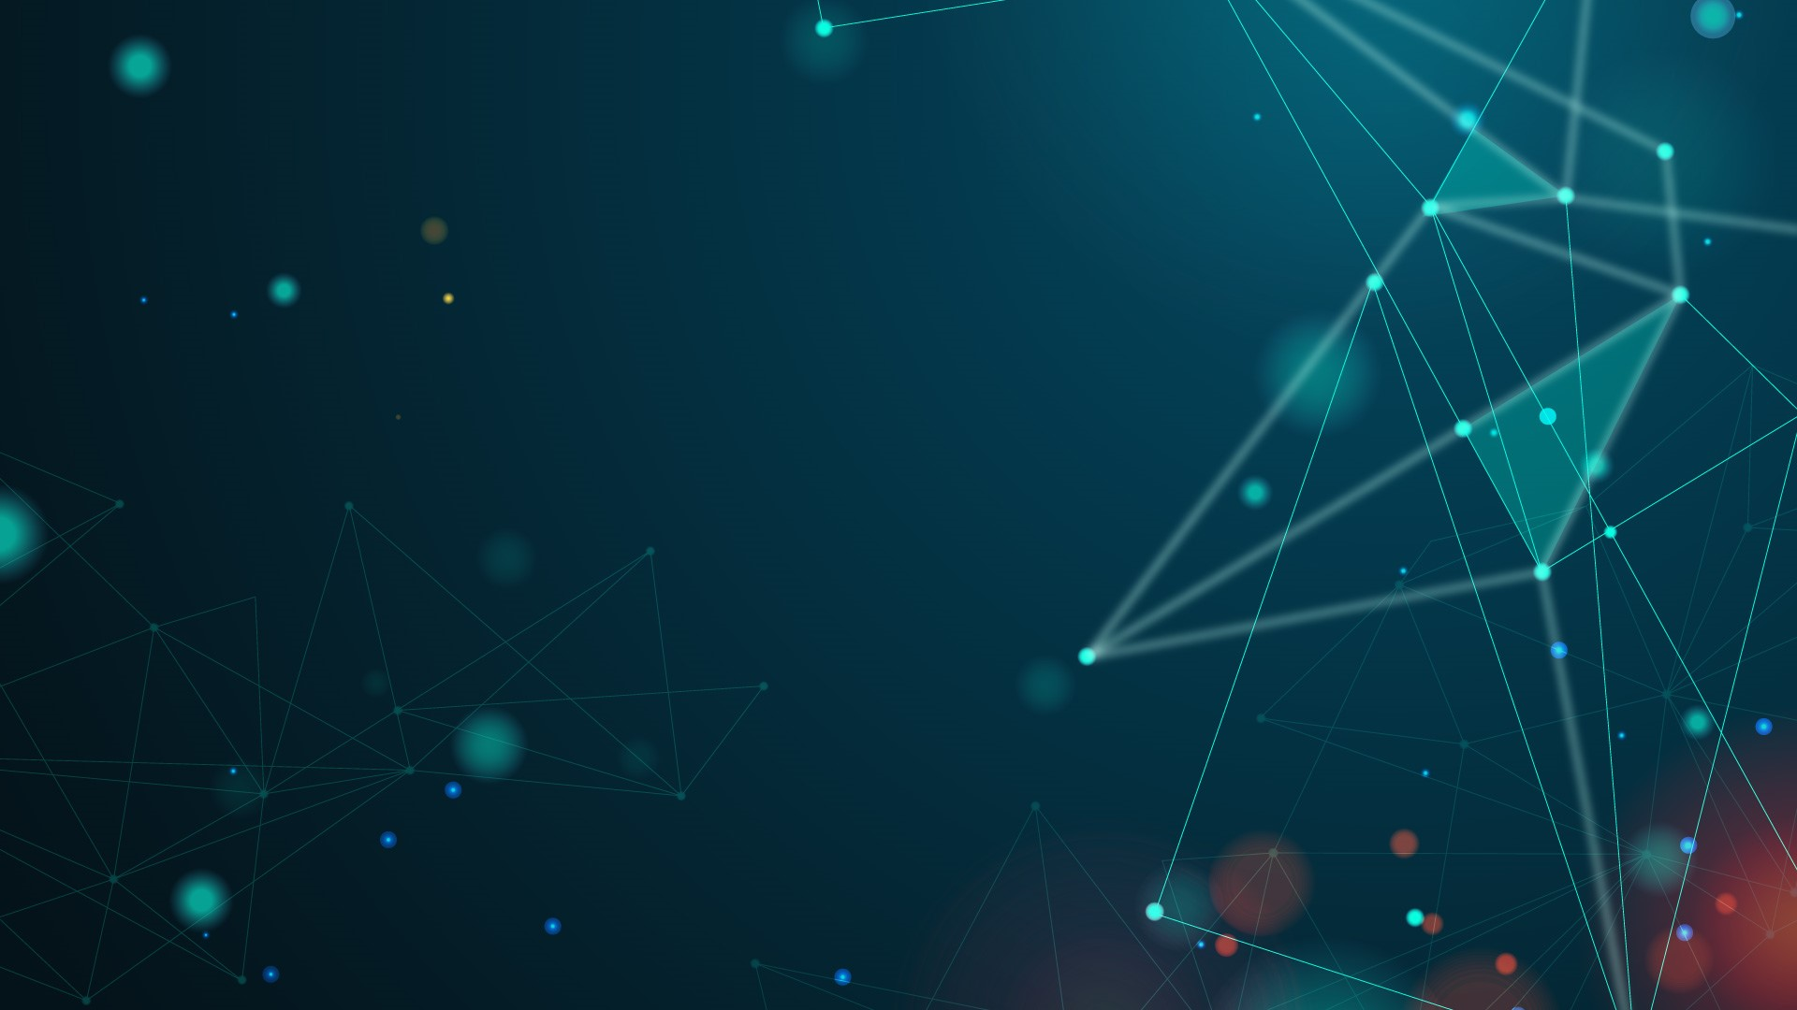

Biography
Season 3
Notes:
Welcome to Biography Season 3! Where the life stories of various historical figures and celebrities are told.
Today, we will be talking about someone who revolutionised the 21st century across various industries.

Slide 2
Elon Musk
Notes:
And that would be none other than Mr. Elon Musk!

Slide 3
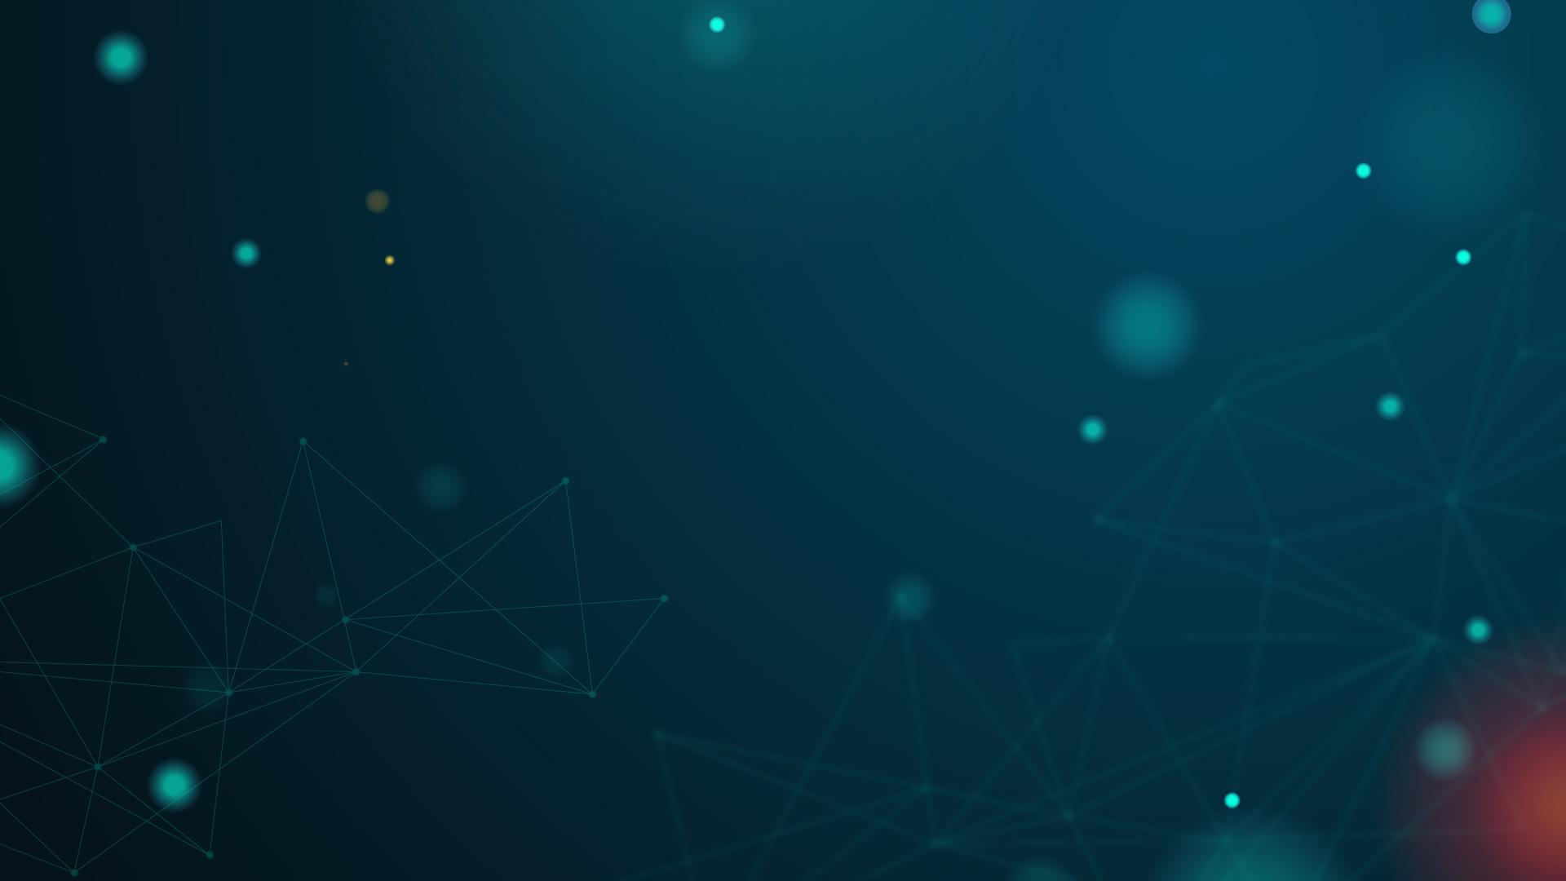
Elon Musk
Steve Davis
Tosca Musk
Entrepreneurial Journey
Corporate Journey with Musk
Personal and Family Journey with Musk
Notes:
Today, we have Ms Tosca Musk, Mr Elon Musk’s sister and Mr Steve Davis, colleague and business director leading the Boring Company.
Give a round of applause for this Super Star, Mr Elon Musk everybody!
Kevin: Thank you Reh! It’s an honor to be part of this show!
Reh: Now without further ado, I would like to ask Elon’s sister, Ms Tosca Musk, a very important question. Now, how was it growing up with Mr. Revolution aka Elon Musk. Family would know best so give it to us Tosca, we would like to know about your brother’s biography! What would you like to share with regards to his personal life and journey?

Slide 4
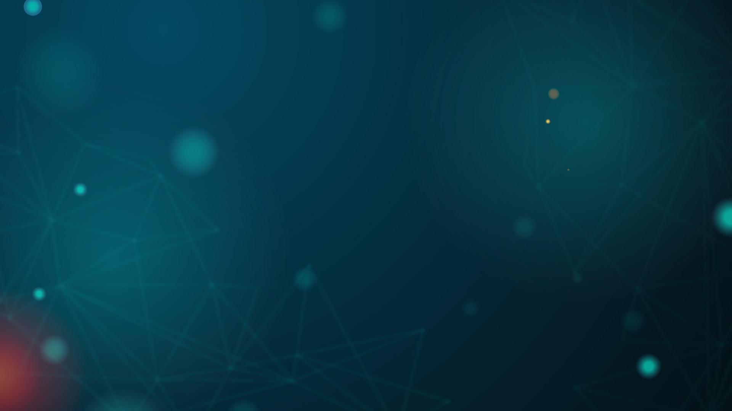

Personal Life - At Child
Born 28, 1971, in Pretoria, South Africa
Unhappy childhood
Parents divorced at 10
Always bullied at school
Fascinated with Technology
Created Blastar - a video game in the style of Space Invaders
Sold the BASIC code for $500
Notes:
Thanks, Reh, that’s an awesome question.
So... my brother Elon was born on June 28, 1971, in Pretoria, South Africa. He is born and raised in South Africa where we spent time in Canada before finally moving to the U.S
As a child, I remember that Elon was really unhappy. At the age of 10 our parents divorced and he was often buillied in school. Elon was a bookworm and something of a smart aleck. I think his intellectual aptitude did him few favors as a child. I remember his schooling days were spent being chased around by gangs who tried to beat him up and bullied him.
As a family, we all knew that Elon was different from all of us. More of often than not I would catch him so lost in his daydreams about inventions and about technology. When he was only 10, he became acquainted with programming and became proficient enough to create Blastar—a video game in the style of Space Invaders. He sold the BASIC code for the game to a magazine called PC and Office Technology for $500. All I can say is Elon is really bright as a kid.

Slide 5
Personal Life - At College
Took Bachelor of Science in Physics and Bachelor of Arts in Economics from the Wharton School at UPenn
While studying, he and a classmate turned a 10 bedroom house into a nightclub
Dropped out of his PHD program in applied physics at Stanford, 2 days after enrolling
Developed Zip2 which late sold for $340M
Notes:
In college, Musk really thrived, he took on a Bachelor of Science in Physics, as well as a Bachelor of Arts in Economics from the Wharton School. I believe that these two majors speak to the direction Musk’s career would take later, but it was physics that made the deepest impression.
Its not all fun and no play while studying at the University of Pennsylvania, Musk and a classmate rented out a 10-bedroom frat house and turned it into a nightclub. The move, which Musk undertook with Adeo Ressi, was one of his first entrepreneurial experiments.
After college, Initially on track to pursue a Ph.D. in applied physics at Stanford University quit his Ph.D. program after just two days to pursue his entrepreneurial dreams.

Slide 6
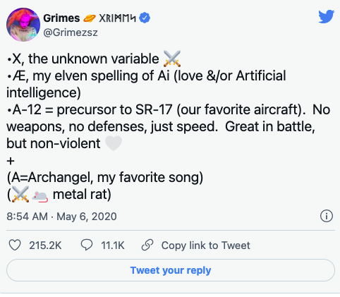
Personal Life - Interesting Nugget
Obsession with Technology is so instance that he gave his newborn son an “sciency” name
"X Æ A-12"
Pronounced as “X Ash A Twelve”
Notes:
My brother’s fascination for science is really crazy and can be seen extending to his personal life. Just this year, him and singer Grimes announced their newborn son would be named X Æ A-12 Musk — pronounced X-Ash-A-12.
Personally, I am really proud of Elon and where he is today. His obession with technology, creativity and more importanlty work ethics is really admireable. His success if not by accident. He worked for more that 100hrs for 15 years can you imagine that?
That’s all I have to share about my brother’s personal life and journey, I am sure the others will have a lot of say about his entrepreneurial journey and other interesting nuggets about his life.

Slide 7
Accomplishment
03
Notes:
Thank you so much Tosca. That was a very well-articulated summary of Elon Musk’s personal life and journey.
He sure has lived up to his name - He clearly did not have it easy growing up and sure is a role-model for all aspiring entrepreneurs.
Now, let us ask Elon himself. Everyone must have heard about X.com, Paypal, SpaceX, Tesla and many more significant business developments. What do you think are some significant phases in your entrepreneurial journey Mr Musk?

Slide 8
PayPal and X.com
Found X.com, online financial services and email payment
Merged with Confinity
Confinity own PayPal
Sacked from PayPal :(
Notes:
Well, in 1999, I co-founded X.com with my brother, which is an online financial services and email payment company. This company was later merged with an online bank named Confinity to prevent unnecessary competition. Confinity itself is the owner of PayPal which is more popular than X.com that time. So, I did not found PayPal, I was just appointed as the CEO when Confinity merge with X.com. However, this does not went well, and I was sacked from the board as I was too young that time and the board feel I am not experienced enough. I was shocked at that time, and did not expect I will get sacked very early in my career.
Reh: Well, that’s very interesting. However, I, along with many other fans of yours across the globe would like to know How did a revolutionary business developer and creator like yourself transition your entrepreneurial journey from the finance sector into space research and space travel?

Slide 9
SpaceX
Starting SpaceX
Based on passion in space exploration
Mars Society
Involved in human exploration and settlement of Mars
Failures
3 failed rocket launches
Notes:
In 2001, after being sacked by PayPal, I did not give up. I later become involved with Mars Society, which is space advocacy organization promoting human exploration and settlement of Mars. Since I was young, I am passionate in space exploration and that’s why I decided to start my next company SpaceX in 2002. The experience that I had with SpaceX is also crucial in my life. We had three failed rocket launches and finally made it in 2008.
Next slide

Slide 10
SpaceX
2008
First successful rocket launch
First liquid fuel rocket to reach Earth Orbit
Notes:
we made it firstly in 2008, this was the first liquid fuel rocket to reach the Earth orbit. After 2008 success, I had received billion of investment from different investors that help us to reach the point we are now. You know, I always have passion for space exploration. And honestly, the goal for SpaceX is to improve the cost and reliability access to space. So this achievement in 2008 is a major step for us and we are very proud of this. I hope in the coming years, we are able to really bring people to Mars
Reh: That is very inspiring and shows to the rest of the world that if you have the right intention at heart and have the motivation to work hard towards your goal, you can indeed achieve anything in life. You have ventured out from the finance sector to space travel and research successfully. Now, of course I have to ask about your venture into cars. TESLA. Yes, it is considered illegal if I have you on this show and not ask about Tesla. Now, tell us how you got started off with this idea and why did you start Tesla.

Slide 11
Tesla
Founded in 2003
Pioneer Investor
By Martin Eberhard and Marc Tarpening
Significant amount of investment and joined the board
First Electric Car
Achievement
Use Lithium-ion battery
Sales of 500,000 units in March 2020
Notes:
Well Tesla is also another company that I am passionate about. Originally, tesla was found in 2003 by Martin Eberhard and Marc Tarpening, and I made significant amount of investment and become the majority shareholder and joined the board of director.
Before I mention about Tesla achievement, I think I also need to mention the challenges that the company face. You know, the idea of autonomous driving is not very intuitive to lots of people. This is because some people might consider these ideas are really dangerous, and relying on AI itself to navigate might not resonate well with many people. However, we manage to overcome these barrier, and reach the success.
We manage to build the first electric car in 2008, and it was the first electric car to use lithium-ion battery cells. We began to produce four door electric car in 2012, and we manage to sell more than 500k units as of March 2020. This is a significant achievement for me and all Tesla employees.
Next slide

Slide 12
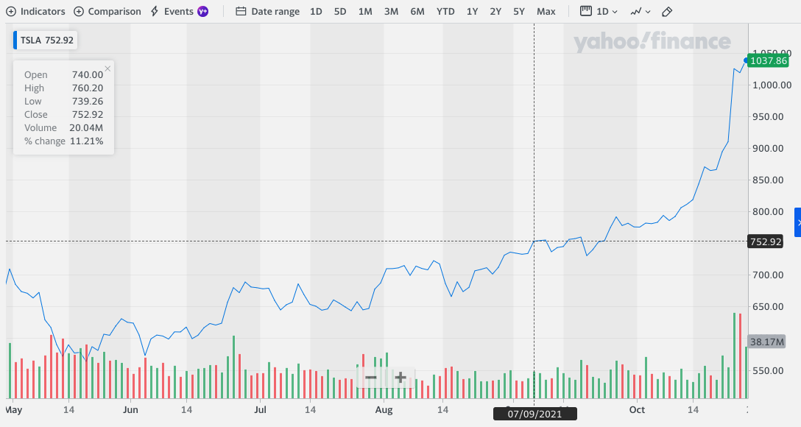
Tesla
Notes:
Moreover, Tesla stock just made another all-time high last week after the split in 2020. I am very proud of this achievement and these are the results of the hard working of myself and my team.
Reh: That is very inspiring and motivating Mr Musk. I would like to ask for any key learning points from your experiences as it would help motivate aspiring youth entrepreneurs
Kevin: I learn a lot during my experience from PayPal, SpaceX, and Tesla. What distinguish who I am now to other person is probably my passion, and my hardworking traits. When I start SpaceX, I spent significant amount of time working on the prototype and other stuff and sacrifice a lot of things to make it work. In addition, as an engineer, I think it is very important to keep innovating especially nowadays the world is rapidly changing. 30 years ago, we never expect that internet would be like what it is today.
Reh: Thank you so much for your sharing Mr Musk. Your entrepreneurial journey is extremely inspiring and eye-opening to many aspiring entrepreneurs including myself!

Slide 13
Solarcity
04
Mr Jerome Guillen
Notes:
Reh: Now I would like to welcome Mr Jerome Guillen, who was initial employee of Tesla and held important position in the company to talk about SolarCity, a subsidiary under Tesla.

Slide 14
WHAT IS SOLARCITY?
Establishments
Acquisition
Elon Musk’s mission
Founded on July 4, 2006 by Peter and Lyndon Rive, cousins of Elon Musk
In 2016, Tesla acquired SolarCity for $2.6 billions
Accelerate the world’s transition to sustainable energy

Slide 15
SOLARCITY’S PRODUCTS AND SERVICES
01 | 02 | 03 | 04
Solar leasing | Commercial solar panels | Energy efficiency and retrofits | electric vehicle charger

Slide 16
Boring Company
05
Mr Steve Davis
Notes:
Reh: Thank you Mr Guillen! Now, I would like to invite Steve Davis who has already working with Elon Musk from early stage of Space X and now he is leading Boring Company, which is another company that Elon Musk has already incubated from 2016.

Slide 17

Infrastructure and tunnel construction services
Notes:
Louis: Wow, that is my pleasure to be here and share with you about my journey with Elon Musk in Boring Company. Our company is an infrastructure and tunnel construction services company founded by Elon Musk. Its current and proposed projects are designed for intra-city ("loop") transit systems, although the company has stated that current tunnels are being built so we could support eventual transition to Hyperloop-based transportation on longer inter-city routes.

Slide 18
HYPERLOOP
TRANSPORTATION SYSTEM
IDEATION
Scaled tube or system of tubes with low air pressure
White paper concept in 2013, proposing a route from Los Angeles to Bay Area
SYSTEM SPECS
OFFICIAL ESTABLISHMENT
Travel 560 km route at speed of 1200 km/h in 35 minutes
In 2018, Boring Company spun out from Space X as separate entity.
Notes:
So are u curious about what is hyperloop??? A Hyperloop is a proposed high-speed mass transportation system for both passenger and freight transport.[1] The term was invented to describe the modern open-source project. Hyperloop is described as a sealed tube or system of tubes with low air pressure through which a pod may travel substantially free of air resistance or friction.

Slide 19
Elon Musk and crypto
06
New York Time reporter
Notes:
Reh: Elon Musk has always been an inspiration for young generations with his visionary business ideas. However, he also has bad reputation for controversial tweet on the Internet especially during the boom of cryptocurrency recently. So now, let hear from a New York Time reporter for this perspective.

Slide 20
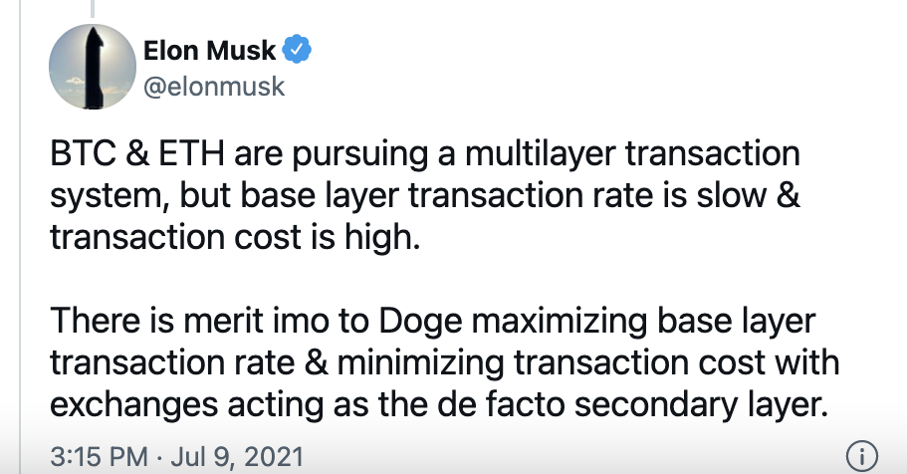
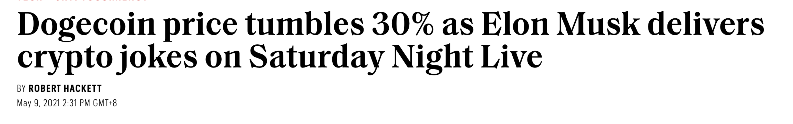
DogeCoin Tweet
Notes:
Well, Billionaire Elon Musk has often been responsible for pumping doge and other cryptocurrency prices on several occasions by sharing various references and memes on his social media feed as he is known for his interest on digital tokens and remains a strong believer of cryptos. Here is one example new about the dodge coin. So after his joke on Saturday Night Live, the DogeCoin price tumbles 30%

Slide 21
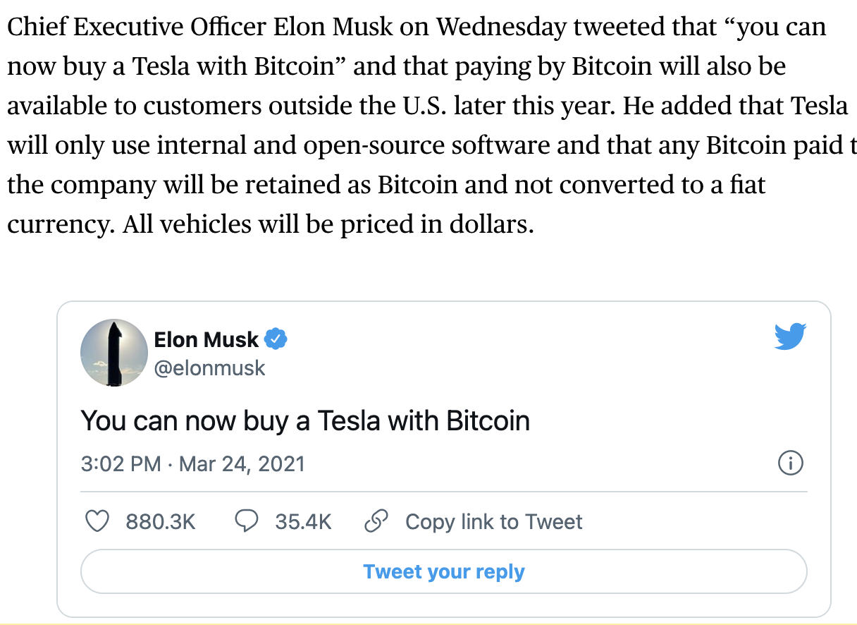
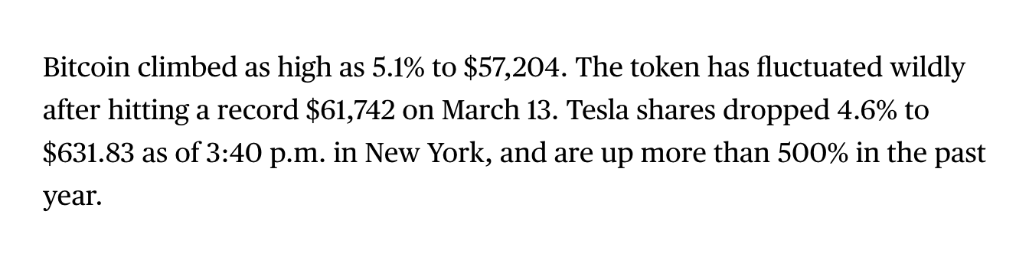
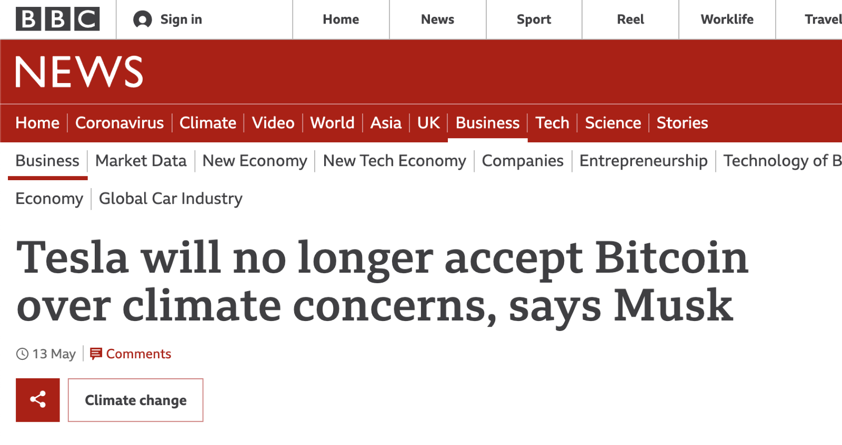
Tesla and Bitcoin
Notes:
Another typical news recently is about Tesla’s acceptance for BTC to purchase caron 24th March. Suddenly, after this tweets, the price of BTC climbs by 5.15%
However, on 13th May, they stop accepting BTC over climate concerns. Bitcoin fell more than 10% after Musk tweeted his decision to suspend its use, less than two months after Tesla began accepting the world's biggest digital currency for payment.
So we can see that Elon Musk has a lot of attention from public that he can even controls the prices of crypto coins.

Slide 22
Learning Points and Conclusion
Persistence Pays
Focus on the impact of your dreams, not the odds
Talent can't compensate for a lousy personality
Notes:
this advice is coming from a man who wants to colonize Mars. Are you dreams really more of a long shot than that?
Not all of the lessons of Musk's career are off the wall and unexpected. Sometimes, he proves that conventional wisdom is right. Like with this quote: "Persistence is very important. You should not give up unless you are forced to give up."
My biggest mistake is probably weighing too much on someone's talent and not someone's personality. I think it matters whether someone has a good heart." So, once more with feeling: don't hire jerks!

Slide 23

Thank you
Any Questions?

